Slide 1



MNC Data Analysis using SQL
Comprehensive analysis of employee records, salaries, performance metrics, and attrition patterns using advanced SQL techniques including CTEs, window functions, aggregations, and joins.
Presented by -Suman Saha
Data Analyst
10-09-2025

Slide 2
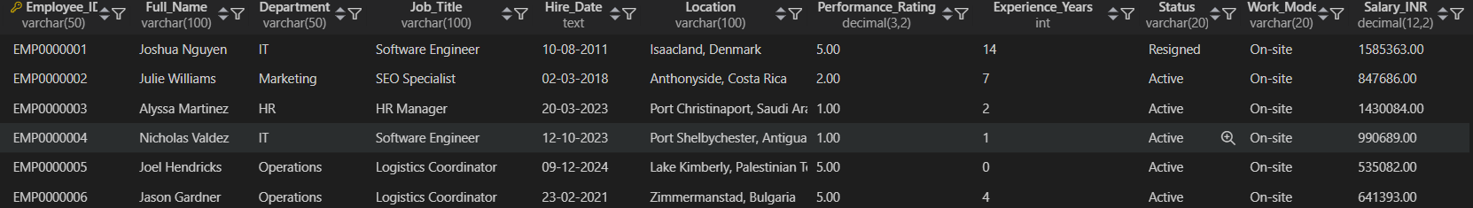
CREATE VIEW cl_hr_data AS (
SELECT
employee_id,
full_name,
department,
job_title,
(STR_TO_DATE(hire_date, '%d-%m-%Y')) AS date_of_hire,
LEFT(location,LOCATE(',', location)-1) AS City,
RIGHT(location,LENGTH(location)-LOCATE(',',location)) AS Country,
performance_rating,
experience_years,
status,
work_mode,
salary_inr
FROM hr_data
);
Dataset Overview
MNC Data Structure
Our comprehensive mnc_data table contains 1048575 detailed employee information across multiple dimensions. Key fields include employee identification, personal details, organizational structure, compensation data, and performance metrics.
We created a clean view (cl_hr_data) that extracts refined location data including city and country, plus standardized hire date formatting for enhanced analysis capabilities.
01
Employee Demographics
ID, name, location data
02
Organizational Data
Department, job title, work mode
03
Performance Metrics
Ratings, experience, status
04
SELECT *
FROM HR_DATA;
Compensation
Salary data in INR

Slide 3

Strategic Problem Statement
Salary Trend Analysis
Performance Insights
Identify compensation patterns across departments, roles, and experience levels to ensure competitive and equitable pay structures.
Analyze performance ratings across different employee segments to optimize talent management and development programs.
Attrition Intelligence
Examine turnover patterns to identify risk factors and develop targeted retention strategies for critical departments.
Our analysis provides actionable insights for HR strategy development, enabling data-driven decisions that support sustainable company growth and enhanced employee satisfaction.

Slide 4
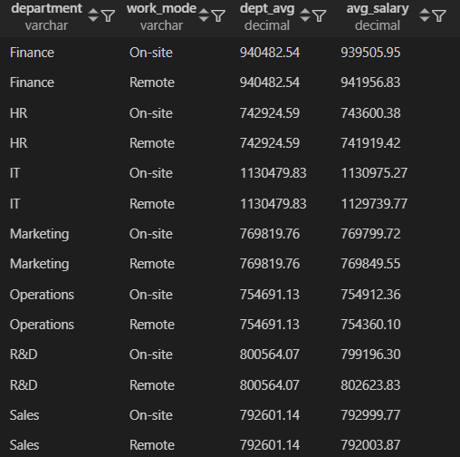
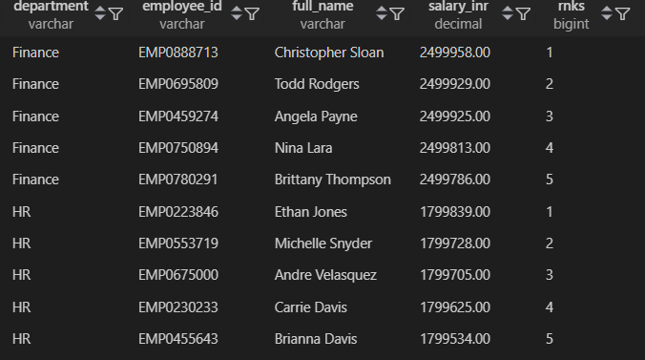
Key Analysis
-- Q1. Find the top 5 highest-paid employees in each department.
-- Q2. Calculate the average salary by department and work mode.
QUERY
WITH top_emp AS (
SELECT
department,
employee_id,
full_name,
salary_inr,
RANK() OVER(PARTITION BY department ORDER BY salary_inr DESC) AS rnks
FROM hr_data
)
SELECT
department,
employee_id,
full_name,
salary_inr,
rnks
FROM top_emp
WHERE rnks <=5;
QUERY
OUTPUT
SELECT
h1.department,
h1.work_mode,
dept_avg,
ROUND(AVG(h1.salary_inr),2) AS avg_salary
FROM hr_data h1
JOIN (
SELECT department,
ROUND(AVG(salary_inr),2) AS dept_avg
FROM hr_data
GROUP BY department
) h2
ON h1.department = h2.department
GROUP BY h1.department, h1.work_mode, h2.dept_avg
ORDER BY department;
OUTPUT
Insight: Shows cost distribution across teams and work styles (Remote/On-site).
Insight: Highlights star performers and helps HR track salary outliers.

Slide 5
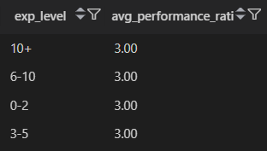
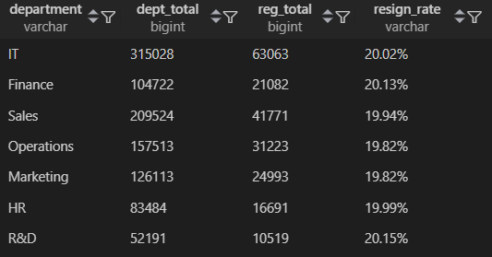
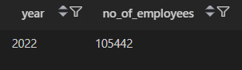
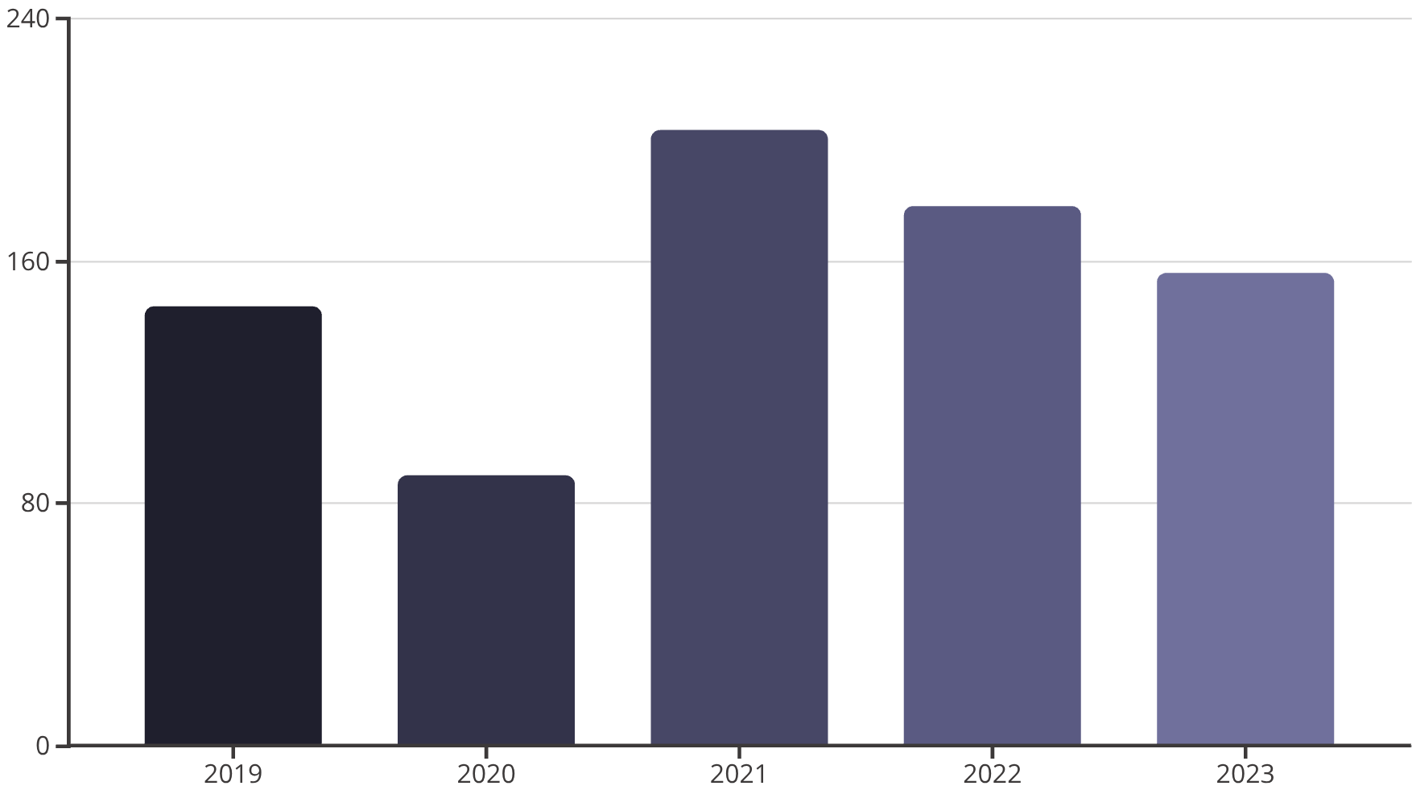
-- Q3. Find the department with the highest attrition rate(Resigned %).
-- Q4. Show the average performance rating by experience level (0-2 yrs, 3-5 yrs, 6-10 yrs, 10+ yrs).
QUERY
WITH cte_total AS (
SELECT
department,
COUNT(*) AS dept_total
FROM hr_data
GROUP BY department
),
cte_reg AS (
SELECT
department,
COUNT(*) AS reg_total
FROM hr_data
WHERE status = 'resigned'
GROUP BY department
)
SELECT
ct.department,
ct.dept_total,
cr.reg_total,
CONCAT(
ROUND(100 * cr.reg_total / ct.dept_total, 2)
,'%') AS resign_rate
FROM cte_total ct
JOIN cte_reg cr
ON ct.department = cr.department;
QUERY
OUTPUT
SELECT
CASE
WHEN experience_years <=2 THEN '0-2'
WHEN experience_years <=5 THEN '3-5'
WHEN experience_years <=10 THEN '6-10'
ELSE '10+'
END AS exp_level,
ROUND(AVG(performance_rating),2) AS avg_performance_rating
FROM hr_data
GROUP BY CASE
WHEN experience_years <=2 THEN '0-2'
WHEN experience_years <=5 THEN '3-5'
WHEN experience_years <=10 THEN '6-10'
ELSE '10+'
END;
Insight: Helps analyze if more experience translates into better performance.
-- Q5. Find the year with the highest number of hires.
OUTPUT
QUERY
OUTPUT
SELECT
YEAR(date_of_hire) AS year,
COUNT(*) AS no_of_employees
FROM cl_hr_data
GROUP BY year
ORDER BY no_of_employees DESC
;
Insight: Shows company’s peak expansion/recruitment years.
Insight: Identifies departments with retention challenges for HR intervention.
2023
2020
2022
2024
2021

Slide 6

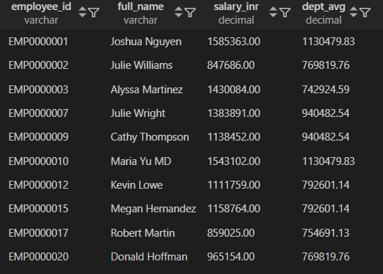
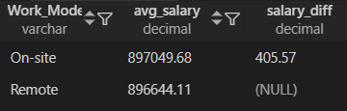
-- Q6. Identify employees whose salary is above the department average.
QUERY
OUTPUT
SELECT
h1.employee_id,
h1.full_name,
h1.salary_inr,
h2.dept_avg
FROM hr_data h1
JOIN (
SELECT
department,
ROUND(AVG(salary_inr),2) AS dept_avg
FROM hr_data
GROUP BY department
) h2
ON h1.department = h2.department
WHERE h1.salary_inr > h2.dept_avg;
Insight: Useful for spotting high performers or possible salary imbalances.
-- Q7. Show the average salary difference between Remote, and On-site workers.
QUERY
OUTPUT
WITH avg_salary AS (
SELECT
work_mode,
ROUND(AVG(salary_inr),2) AS avg_salary
FROM hr_data
GROUP BY work_mode
)
SELECT
Work_Mode,
avg_salary,
avg_salary - LEAD(avg_salary) OVER() AS salary_diff
FROM avg_salary ;
Insight: Reveals if work mode influences compensation.

Slide 7

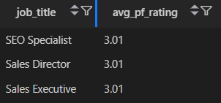
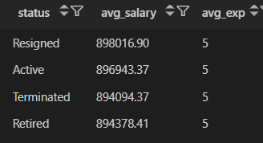
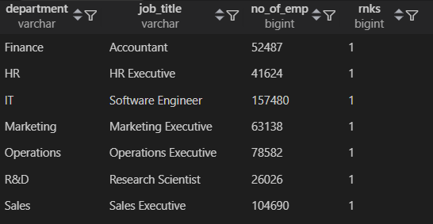
-- Q8. Find the top 3 job titles with the highest average performance rating.
QUERY
SELECT
job_title,
ROUND(AVG(performance_rating),2) AS avg_pf_rating
FROM hr_data
GROUP BY job_title
ORDER BY avg_pf_rating DESC
LIMIT 3;
OUTPUT
Insight: Identifies roles that consistently attract high-performing employees.
-- Q9. Compare active vs resigned employees' average salary and experience.
QUERY
SELECT
status,
ROUND(AVG(salary_inr),2) AS avg_salary,
ROUND(AVG(experience_years)) AS avg_exp
FROM hr_data
GROUP BY status;
OUTPUT
Insight: Shows whether higher pay/experience reduces attrition.
-- Q10. For each department, find the most common job title.
QUERY
WITH cmn_job_title AS (
SELECT
department,
job_title,
COUNT(*) AS no_of_emp,
RANK() OVER(PARTITION BY Department ORDER BY COUNT(*) DESC) AS rnks
FROM hr_data
GROUP BY department, job_title
ORDER BY department
)
SELECT
department,
job_title,
no_of_emp,
rnks
FROM cmn_job_title
WHERE rnks = 1;
OUTPUT
Insight: Reveals dominant roles in each department.

Slide 8
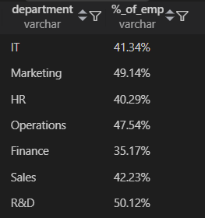
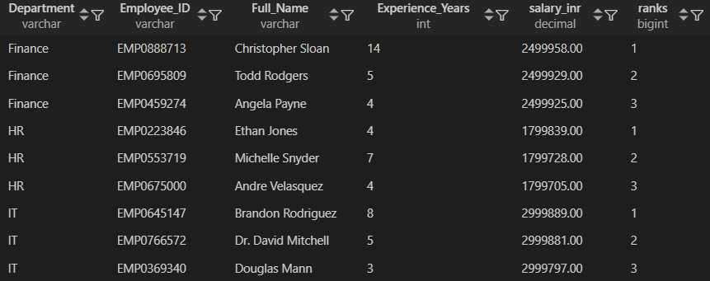
-- Q11. Find the top 3 highest-paid employees in each department and experience level.
-- Q12. Calculate the percentage of employees in each department who earn above their department’s average salary.
QUERY
QUERY
OUTPUT
WITH top_paid_emp AS (
SELECT
Department,
Employee_ID,
Full_Name,
Experience_Years,
salary_inr,
RANK() OVER(PARTITION BY Department ORDER BY salary_inr DESC) AS ranks
FROM hr_data
)
SELECT *
FROM top_paid_emp
WHERE ranks <= 3;
WITH cte_dept AS (
SELECT
department,
AVG(salary_inr) AS dept_avg_salary,
COUNT(*) AS person_per_dept
FROM hr_data
GROUP BY department
),
above_dept_avg AS (
SELECT
h.department,
COUNT(*) AS above_person
FROM hr_data h
JOIN cte_dept c
ON h.department = c.department
WHERE h.salary_inr > c.dept_avg_salary
GROUP BY h.department
)
SELECT
cd.department,
CONCAT(
ROUND(100 * ad.above_person / cd.person_per_dept,2)
,'%') AS '%_of_emp'
FROM cte_dept cd
JOIN above_dept_avg ad
ON cd.department = ad.department ;
OUTPUT
Insight: Measures pay competitiveness within departments.
Insight: Identifies best-paid talent across both seniority and department.

Slide 9
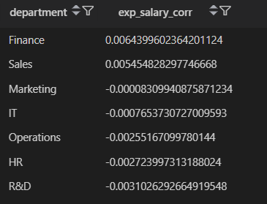
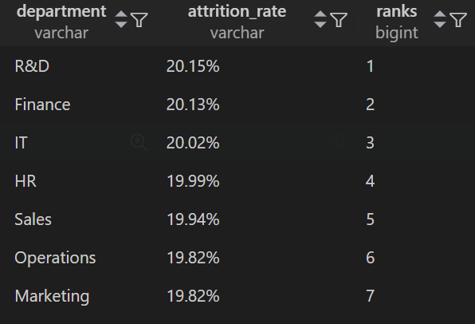
-- Q13. Determine the attrition rate (%) per department and work mode, and rank the departments by highest attrition.
-- Q14. Find the correlation between experience years and salary across departments to see where experience impacts pay the most.
QUERY
WITH cte_total AS (
SELECT
department,
COUNT(*) AS total_person_per_dept
FROM hr_data
GROUP BY department
),
cte_resign AS (
SELECT
department,
COUNT(*) as resign_person_per_dept
FROM hr_data
WHERE status = 'resigned'
GROUP BY department
)
SELECT
ct.department,
CONCAT(
ROUND(
100 * cr.resign_person_per_dept / ct.total_person_per_dept
,2)
,'%') AS attrition_rate,
RANK() OVER(ORDER BY 100 * cr.resign_person_per_dept / ct.total_person_per_dept desc) AS ranks
FROM cte_total ct
JOIN cte_resign cr
ON ct.department = cr.department;
QUERY
SELECT
department,
(
(AVG(experience_years * salary_inr) - (AVG(experience_years) * AVG(salary_inr)))
/
(STDDEV(experience_years) * STDDEV(salary_inr))
) AS exp_salary_corr
FROM hr_data
GROUP BY department
ORDER BY exp_salary_corr DESC;
OUTPUT
OUTPUT
Insight: Reveals if salaries grow with experience and which departments reward it most.
Insight: Identifies risky departments and work setups with high resignations.

Slide 10






Company Insights & Future Growth
Departments with high attrition need urgent attention.
Salary gaps between remote vs on-site need review.
Some departments reward performance better than others.
Correlation analysis helps ensure fair experience-based salary growth.
Insights can guide HR strategies, hiring plans, and employee engagement.

Slide 11
Thank You
Questions & Discussion

